Slide 1
Amazon Sales Data Analysis
By Rima Nandy

Slide 2
Data Source
The primary data is provided by Amazon, which is then pre-processed and collated by me.
The data has been cleaned using Excel and then analysed and presented with insights with the help of Tableau.

Slide 3
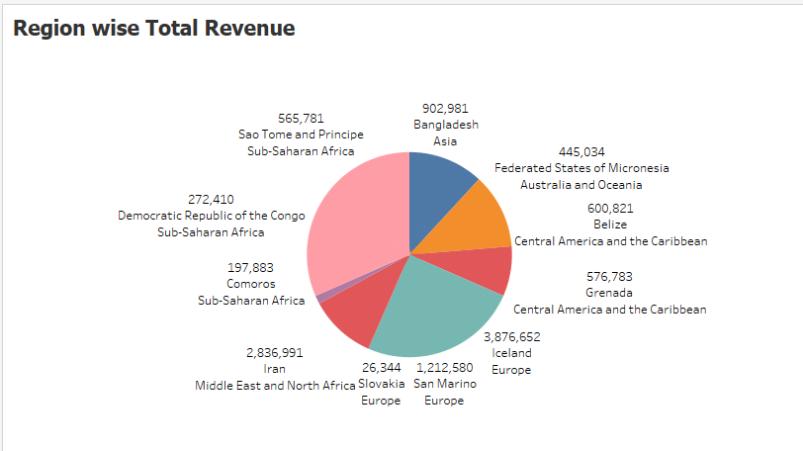
Region-wise total profit

Slide 4
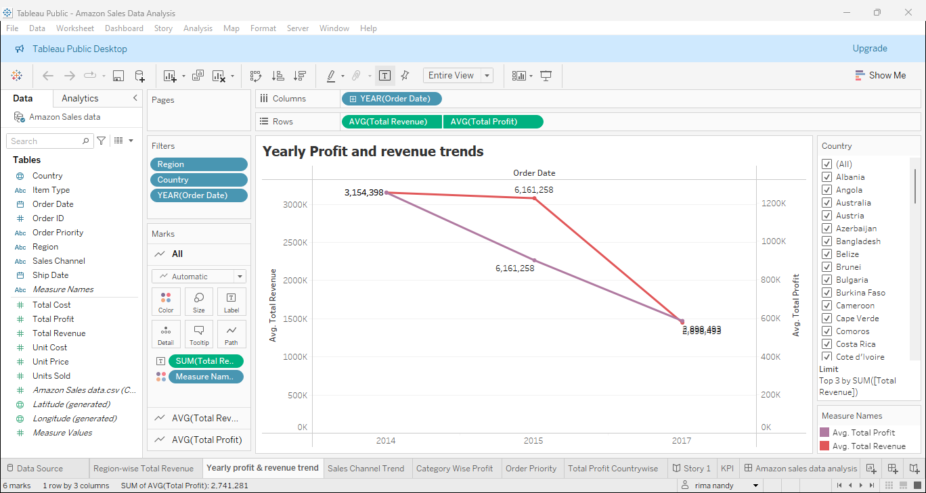
Trend analysis of yearly profit and revenue

Slide 5
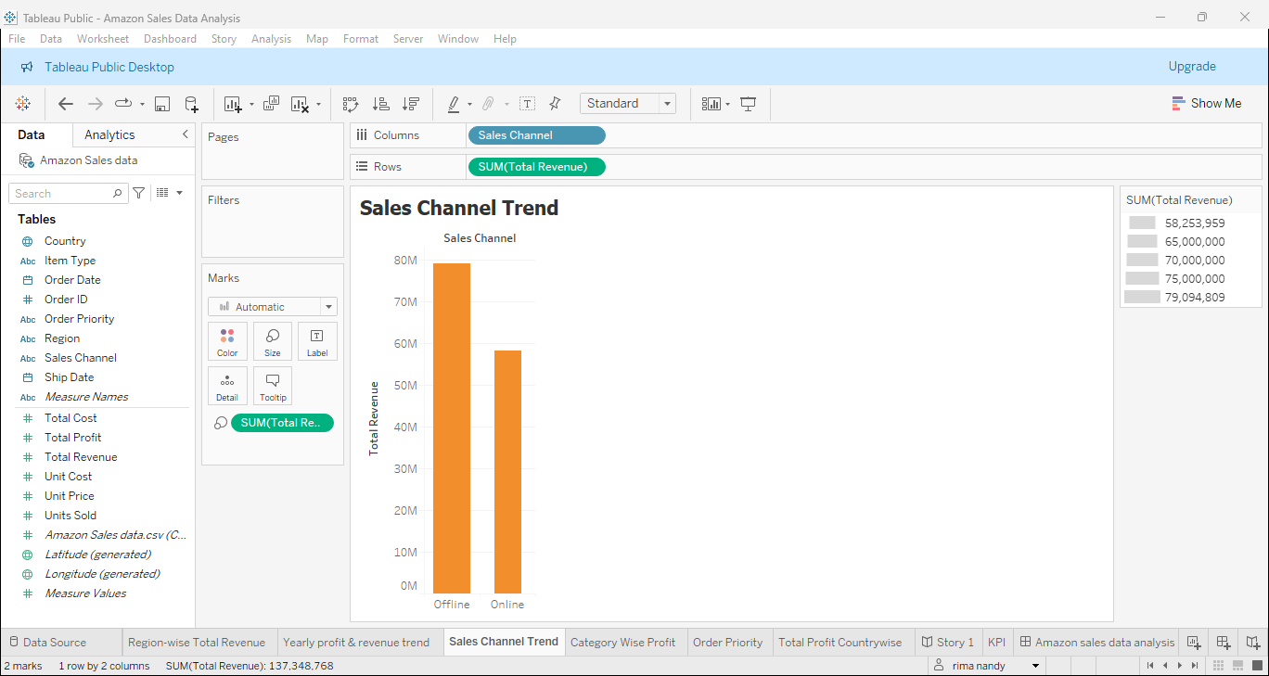
Sales channel analysis

Slide 6
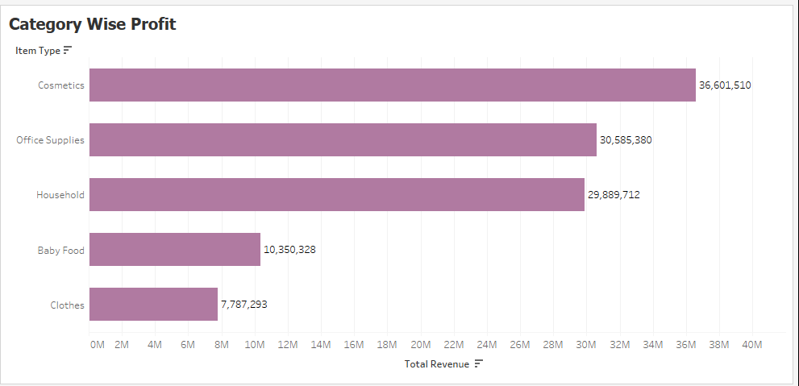
Category Wise Profit

Slide 7
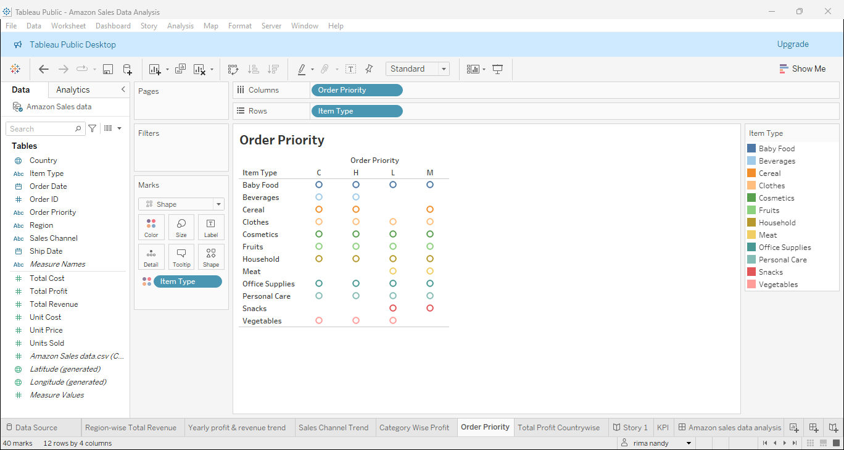
Order Priority in each Product type

Slide 8
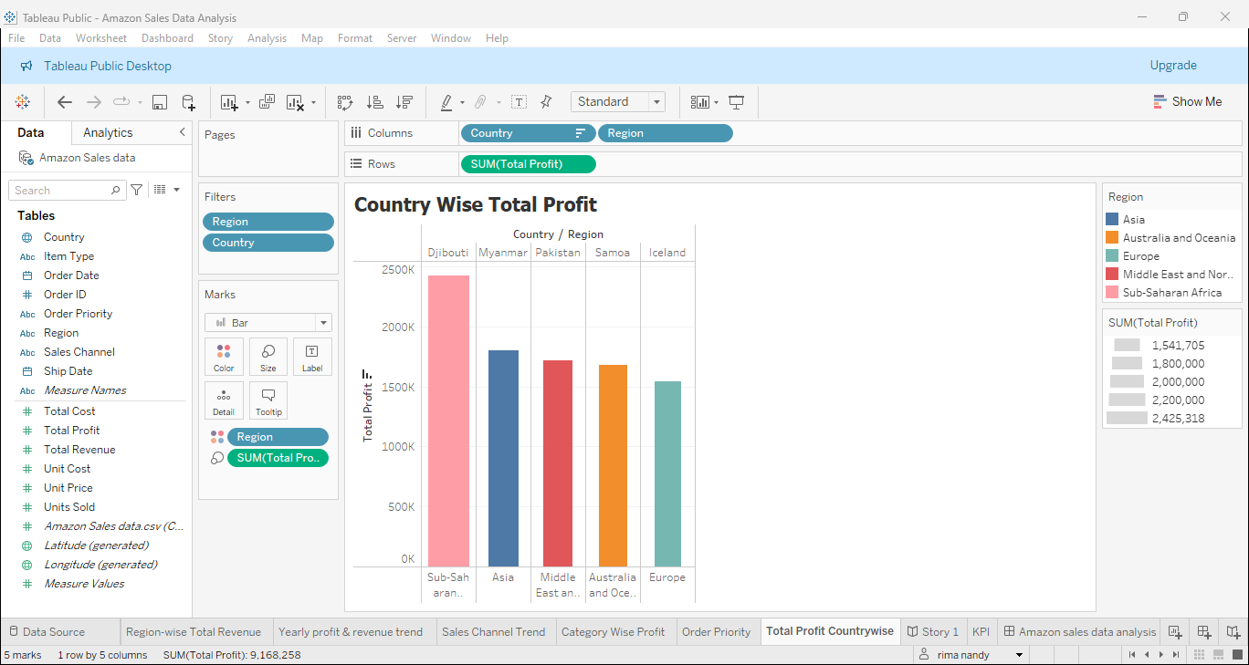
Country wise Total Profit

Slide 9
Amazon Sales Data Analysis
Through the analysis of Amazon Sales Data, the following points can be ascertained:
Region-wise Iceland has the highest revenue of sales followed by San Marino both of them are European countries.
Through yearly profit and revenue analysis, it can be said that 2015 is the most profitable year with the highest yearly revenue.
In sales channel analysis, the offline sales are markedly higher than the online sales.
Category wise, products like cosmetics, office supplies and household make up the largest revenue share.
Priority wise, baby food has the highest priority over all orders.
Country wise, Djibouti in Sub-Saharan Region has the highest profit.

Slide 10
Thank you

